Slide 1
Operating Systems
计算机科学与技术学院
高海昌
hchgao@xidian.edu.cn

Slide 2
Contents
  1. Introduction **
  2. Processes and Threads ******
  3. Deadlocks **
  4. Memory Management *****
  5. Input/Output ***
  6. File Systems ****
  8. Multiple Processor Systems **
  9. Security **
  10. Case study – Linux *

Slide 3
Chapter 3: Deadlocks
  3.1. Resource
  3.2. Introduction to deadlocks
  3.3. The ostrich algorithm
  3.4. Deadlock detection and recovery
  3.5. Deadlock avoidance
  3.6. Deadlock prevention
  3.7. Other issues

Slide 4
Resources
Examples of computer resources
  printers
  tape drives
  tables
Processes need access to resources in reasonable order
Suppose a process holds resource A and requests resource B
  at same time another process holds B and requests A
  both are blocked and remain so

Slide 5
Resources (2)
Deadlocks occur when …
  processes are granted exclusive access to devices
  we refer to these devices generally as resources
Preemptable resources (e.g. memory)
  can be taken away from a process with no ill effects
Nonpreemptable resources (e.g. CD recorder)
  will cause the process to fail if taken away

Slide 6
Resources (3)
Sequence of events required to use a resource
  request the resource
  use the resource
  release the resource
Must wait if request is denied
  requesting process may be blocked
  may fail with error code （用户决定下一步动作）

Slide 7
Resources (4)
typedef int semaphore;
semaphore resource_1;
semaphore resource_2;
void process_A (void) {
down(&resource_1);
down(&resource_2);
use_both_resources();
up(&resource_2);
up(&resource_1);
}
void process_B (void) {
down(&resource_1);
down(&resource_2);
use_both_resources();
up(&resource_2);
up(&resource_1);
}
typedef int semaphore;
semaphore resource_1;
semaphore resource_2;
void process_A (void) {
down(&resource_1);
down(&resource_2);
use_both_resources();
up(&resource_2);
up(&resource_1);
}
void process_B (void) {
down(&resource_2);
down(&resource_1);
use_both_resources();
up(&resource_1);
up(&resource_2);
}
Deadlock-free code
Code with a potential deadlock

Slide 8
Introduction to Deadlocks
Formal definition :
A set of processes is deadlocked if each process in the set is waiting for an event that only another process in the set can cause
Usually the event is release of a currently held resource
None of the processes can …
  run
  release resources
  be awakened

Slide 9
Four Conditions for Deadlock
Mutual exclusion condition
  each resource assigned to 1 process or is available
Hold and wait condition
  process holding resources can request additional
No preemption condition
  previously granted resources cannot forcibly taken away
Circular wait condition
  must be a circular chain of 2 or more processes
  each is waiting for resource held by next member of the chain

Slide 10
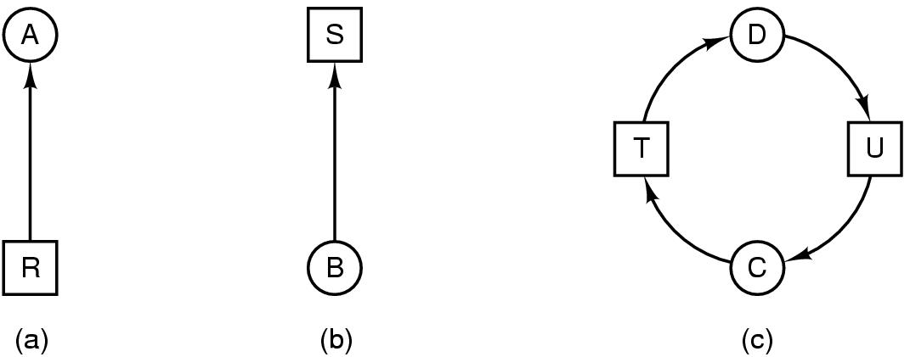
Deadlock Modeling (2)
Modeled with directed graphs
  resource R assigned to process A
  process B is requesting/waiting for resource S
  process C and D are in deadlock over resources T and U

Slide 11
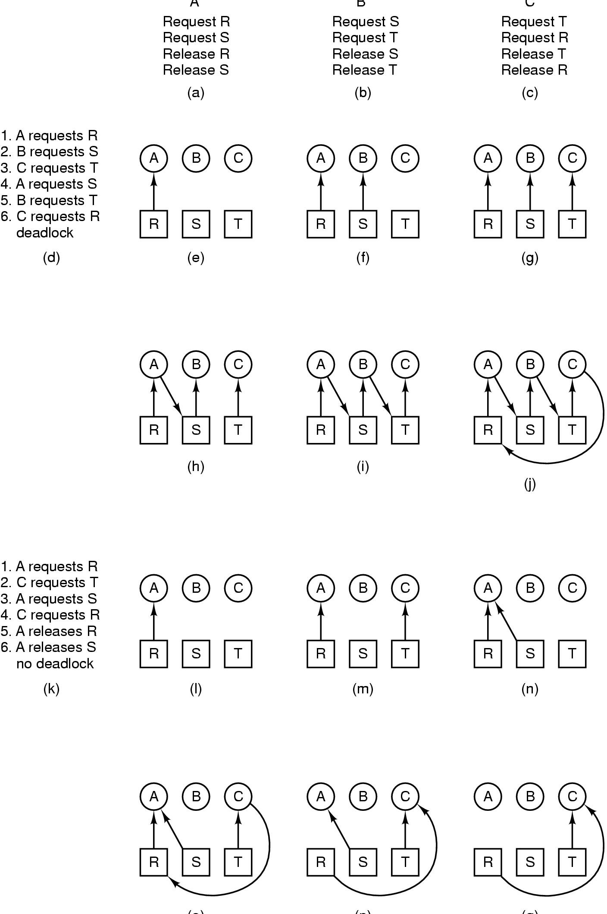
Deadlock Modeling (3)
How deadlock occurs

Slide 12
Deadlock Modeling (4)
(o) (p) (q)
How deadlock can be avoided (Block B)

Slide 13
Deadlock Modeling (5)
Strategies for dealing with Deadlocks
  just ignore the problem altogether
  detection and recovery
  dynamic avoidance
    careful resource allocation
  prevention
    negating one of the four necessary conditions necessary to cause a deadlock

Slide 14
The Ostrich Algorithm 鸵鸟算法
Pretend there is no problem
Reasonable if
  deadlocks occur very rarely
  cost of prevention is high
UNIX and Windows takes this approach
It is a trade off between
  convenience
  correctness

Slide 15
Deadlock detection and recovery
System does not attempt to prevent deadlocks from occurring.
It lets them occur, tries to detect when this happens, and then takes some action to recover after the fact.

Slide 16

Detection with One Resource of Each Type
P 443 algorithm
Note the resource ownership and requests
A cycle can be found within the graph, denoting deadlock

Slide 17
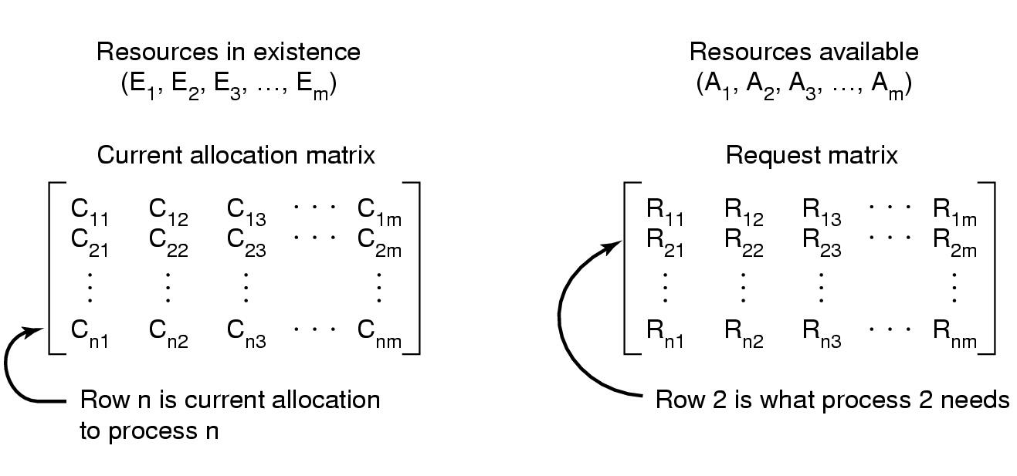
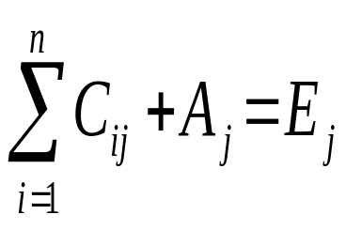
Detection with Multiple Resource of Each Type
Data structures needed by deadlock detection algorithm

Slide 18
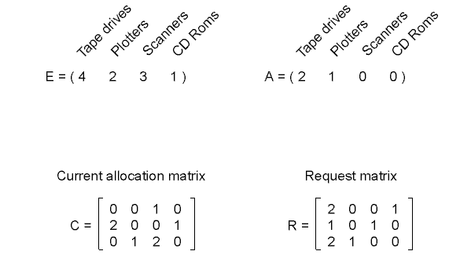
Detection with Multiple Resource of Each Type (2)
An example for the deadlock detection algorithm
( if c2=[2,1,0,1] deadlock)

Slide 19
Recovery from Deadlock
Recovery through preemption
  take a resource from some other process
  depends on nature of the resource
Recovery through rollback
  checkpoint a process periodically (周期性地)
  use this saved state
  restart the process if it is found deadlocked

Slide 20
Recovery from Deadlock (2)
Recovery through killing processes
  crudest but simplest way to break a deadlock
  kill one of the processes in the deadlock cycle
  the other processes get its resources
  choose process that can be rerun from the beginning

Slide 21
Operating Systems
Lesson 2

Slide 22
Deadlock Avoidance
Is there an algorithm that can always avoid deadlock by making the right choice all the time?
The main algorithms for doing deadlock avoidance are based on the concept of safe states.

Slide 23
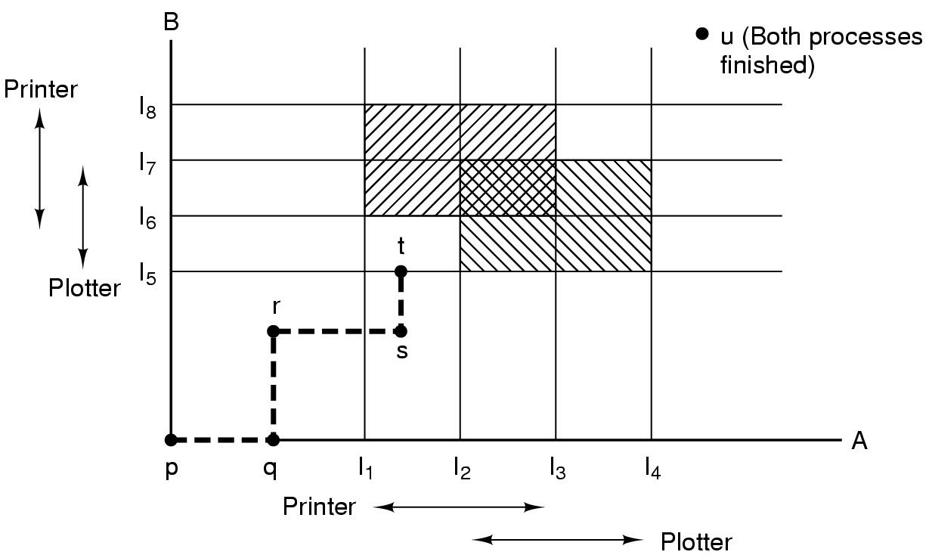
Resource Trajectories
阴影区域
不可进入
Two process resource trajectories

Slide 24
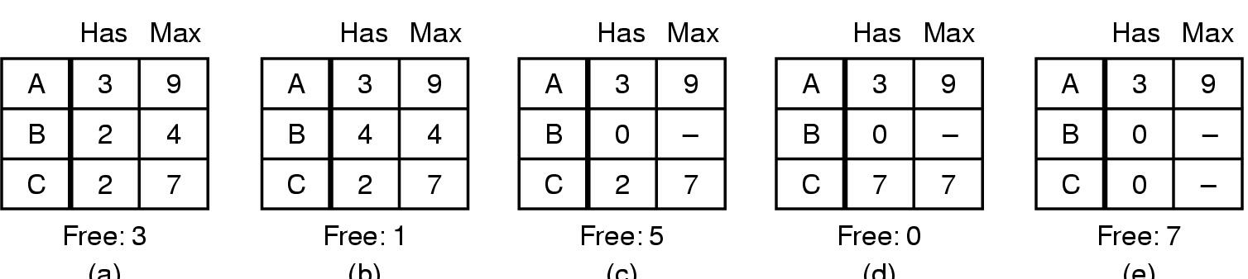
Safe and Unsafe States
(a) (b) (c) (d) (e)
Total=10
Demonstration that the state in (a) is safe

Slide 25
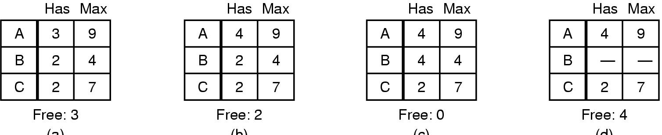
Safe and Unsafe States (2)
(a) (b) (c) (d)
Demonstration that the sate in (b) is not safe

Slide 26
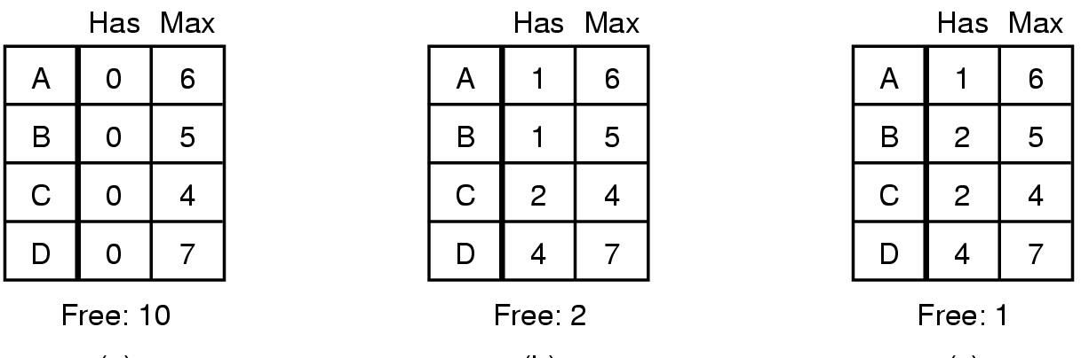
The Banker's Algorithm for a Single Resource
(a) Safe (b) safe (c) unsafe
Three resource allocation states

Slide 27
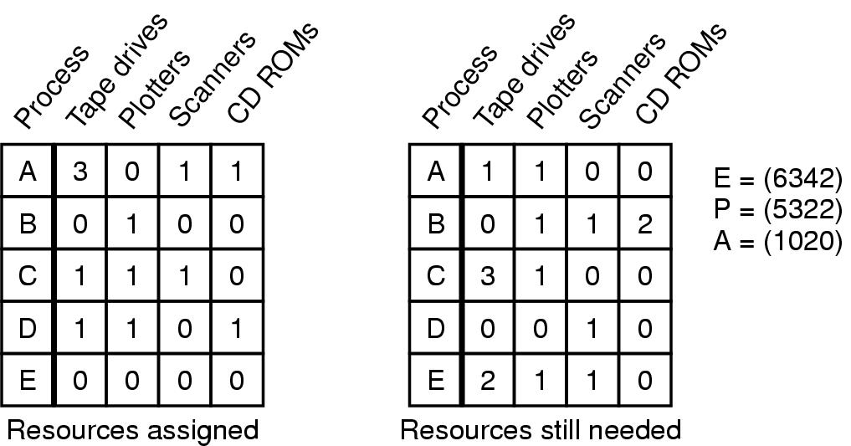
Banker's Algorithm for Multiple Resources
Example of banker's algorithm with multiple resources
E: existing resources P: possessed resources A: available resources
If B(0,1,2,0),deaklock

Slide 28
Deadlock Prevention
Attacking the Mutual Exclusion Condition
Some devices (such as printer) can be spooled (假脱机)
  only the printer daemon uses printer resource
  thus deadlock for printer eliminated
Not all devices can be spooled （process table）
Principle:
  avoid assigning resource when not absolutely necessary
  as few processes as possible actually claim the resource

Slide 29
Attacking the Hold and Wait Condition
Require processes to request resources before starting
  a process has to wait for what it needs
Problems
  may not know required resources at start of run
  also ties up （浪费）resources other processes could be using
Variation:
  process must give up all resources
  then request all immediately needed

Slide 30
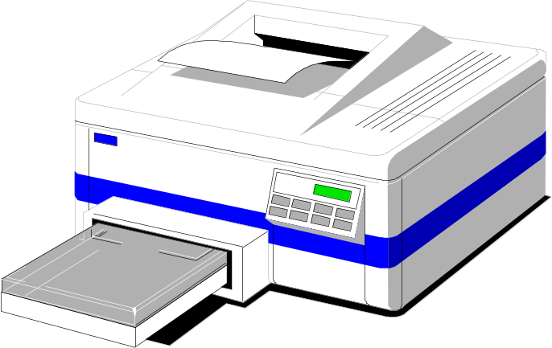
Attacking the No Preemption Condition
This is not a viable option (不可行)
Consider a process given the printer
  halfway through its job
  now forcibly take away printer
  !!??

Slide 31
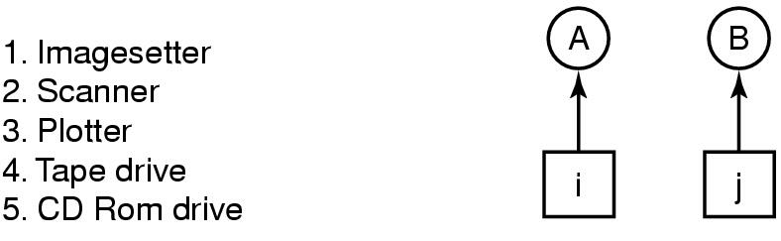
Attacking the Circular Wait Condition
One way: a process is entitled only to a single resource at any moment.
Another: provide a global numbering of all the resources
(a) (b)
Normally ordered resources
No Process request resource lower than what it is already holding
A resource graph ((b) can not be deadlock)

Slide 32
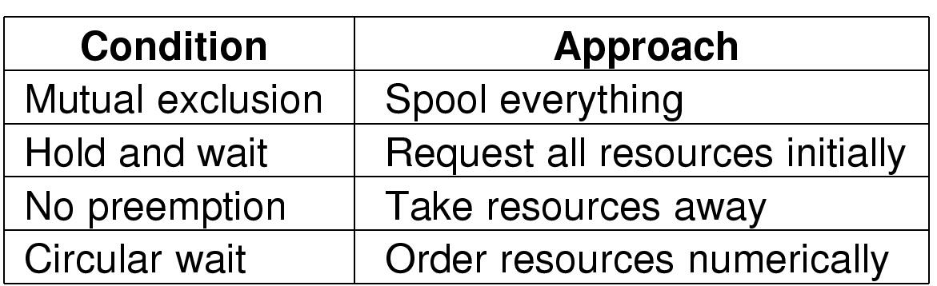
Attacking the Circular Wait Condition (2)
Summary of approaches to deadlock prevention

Slide 33
Other Issues Two-Phase Locking
Phase One
  process tries to lock all records it needs, one at a time
  if needed record found locked, start over
  (no real work done in phase one)
If phase one succeeds, it starts second phase,
  performing updates
  releasing locks
Note similarity to requesting all resources at once
Algorithm works where programmer can arrange
  Only in program can be stopped, restarted
  Not acceptable in real-time system and process control systems

Slide 34
Nonresource Deadlocks
Possible for two processes to deadlock
  each is waiting for the other to do some task
Can happen with semaphores
  each process required to do a down() on two semaphores (mutex and another)
  if done in wrong order, deadlock results

Slide 35
Starvation
Algorithm to allocate a resource
  may be to give to shortest job first
Works great for multiple short jobs in a system
May cause long job to be postponed indefinitely
  even though not blocked
Solution:
  First-come, first-serve policy

Slide 36
练习
Suppose we have four resources: R1,R2,R3, and R4, available: 3,5,6 and 8. Four processes: P1,P2,P3,P4 competing for them. We could have the following situation:
(1) Is the current state a safe state?
(2) P1 request one resource R2, can system allocate R2 to P1? Why?
Resources process | Max needs R1 R2 R3 R4 | Has allocation R1 R2 R3 R4 | Available R1 R2 R3 R4
P1 P2 P3 P4 | 1 2 3 6 1 1 2 2 1 2 1 1 1 1 2 3 | 1 1 2 4 0 1 2 2 1 1 1 0 1 1 1 1 | 0 1 0 1

Slide 37
作业
No.26

